Slide 1
BW Training
Lesson 2: JDBC

Slide 2

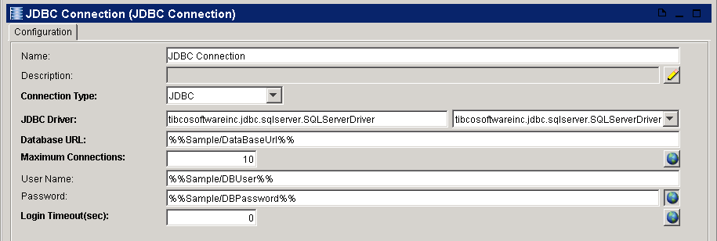
JDBC
JDBC Connection
  Basic setting of the JDBC
  Do test connection

Slide 3
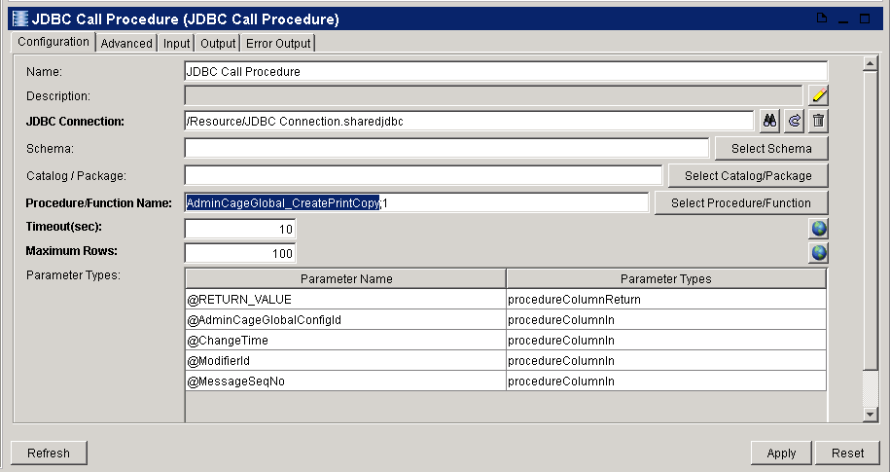
JDBC
JDBC Call Procedure
  Set the JDBC connection and select the store procedure
  Set the time out sec and max row (0 means no limitation)

Slide 4
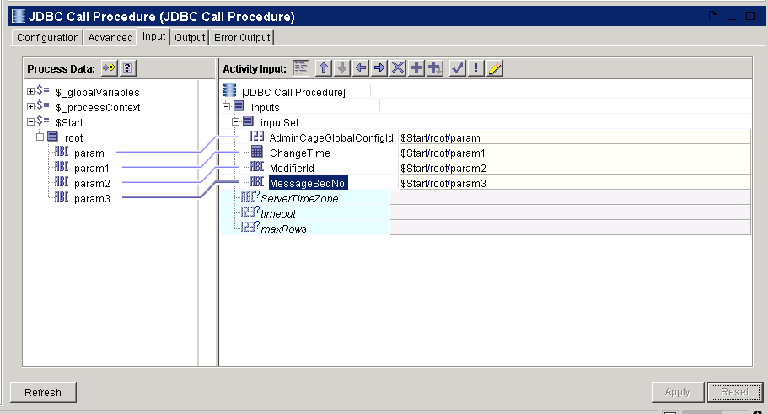
JDBC
JDBC Call Procedure
  Drag and drop the input value

Slide 5
Exercise: A
Use JDBC Call Procedure to query data from DB

Slide 6
Transaction
Summary
  Transactions ensure that all participants in the transaction either complete or are rolled back together
  JDBC transaction manager can only control the JDBC activity
  XA transaction manager can control JDBC IPE JMS activities

Slide 7
JDBC Transaction
Summary
  The JDBC transaction allows multiple JDBC activities that access the same database connection to participate in a transaction
  If you have more than one JDBC Connection in the transaction group, each set of activities that uses a JDBC Connection is considered a separate transaction

Slide 8
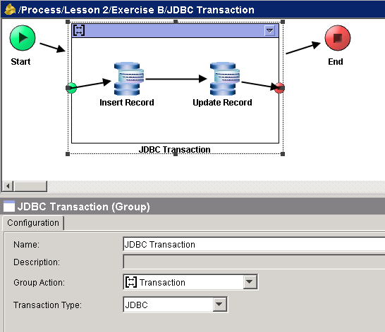
JDBC Transaction
Set up JDBC Transaction
  Group JDBC activities
  Set the group action to transaction
  Set the transaction type to JDBC

